Slide 1
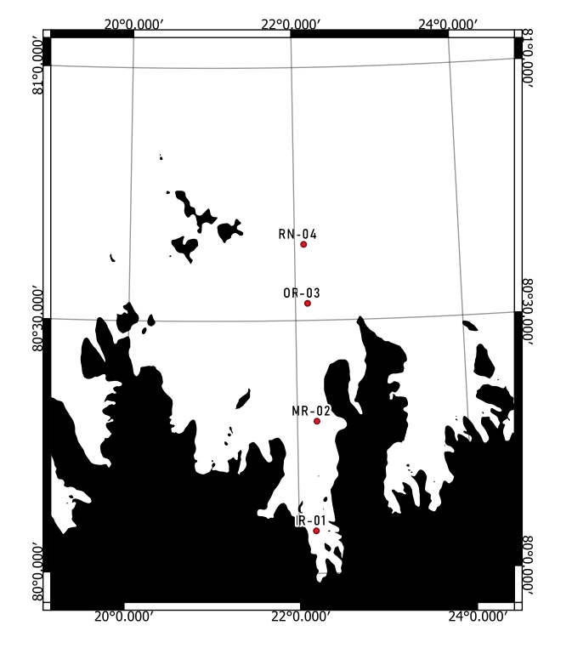
Preliminary Results Time Series Macrofauna Station MR from Rijpfjord
Years: 2007, 2010, 2015 and 2017

Slide 2
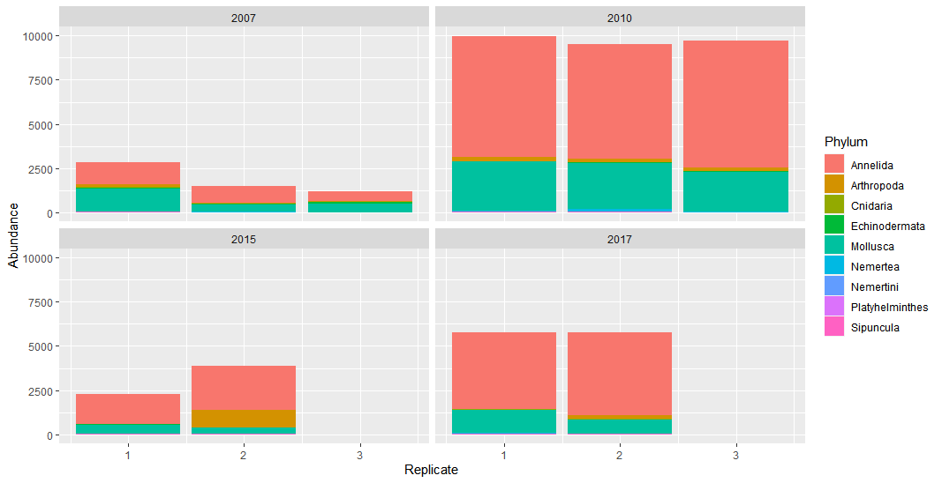
Phylum by Year per replicate
(Ind. /m²)

Slide 3
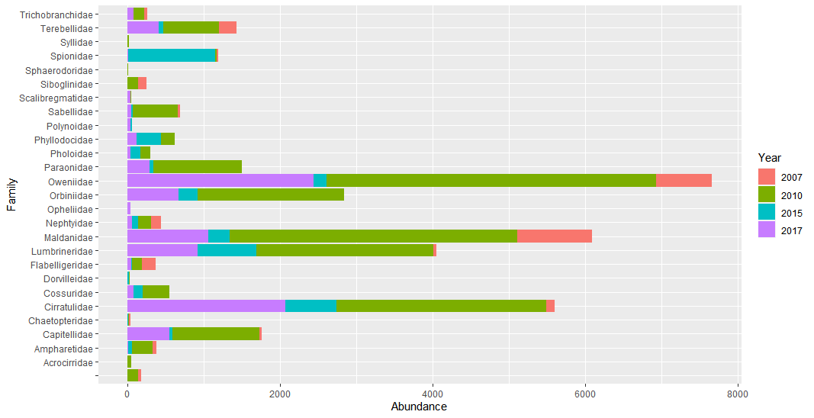
Polychaeta Families by Year
Polychaeta
indet.
(Ind. /m²)

Slide 4
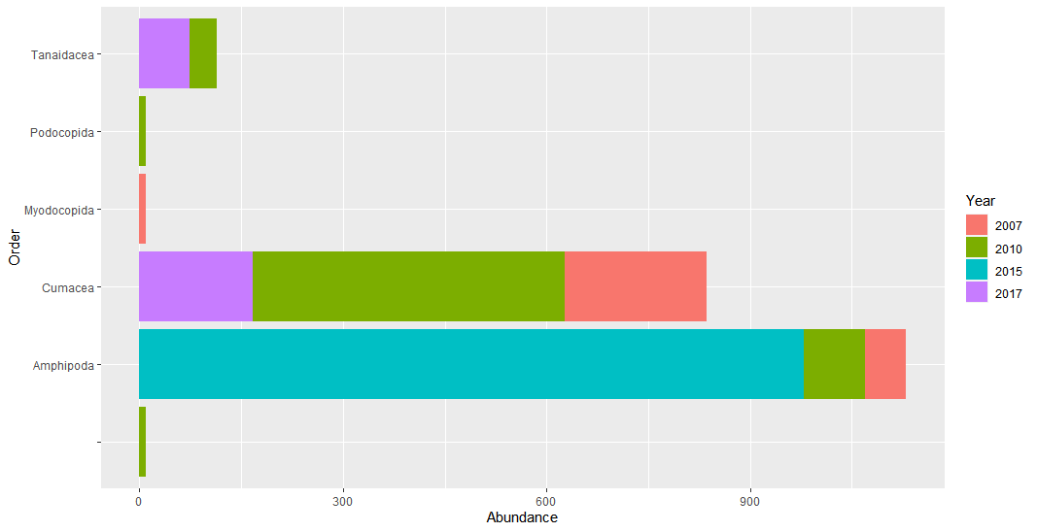
Arthropoda Orders by Year
Others indet.
(Ind. /m²)

Slide 5
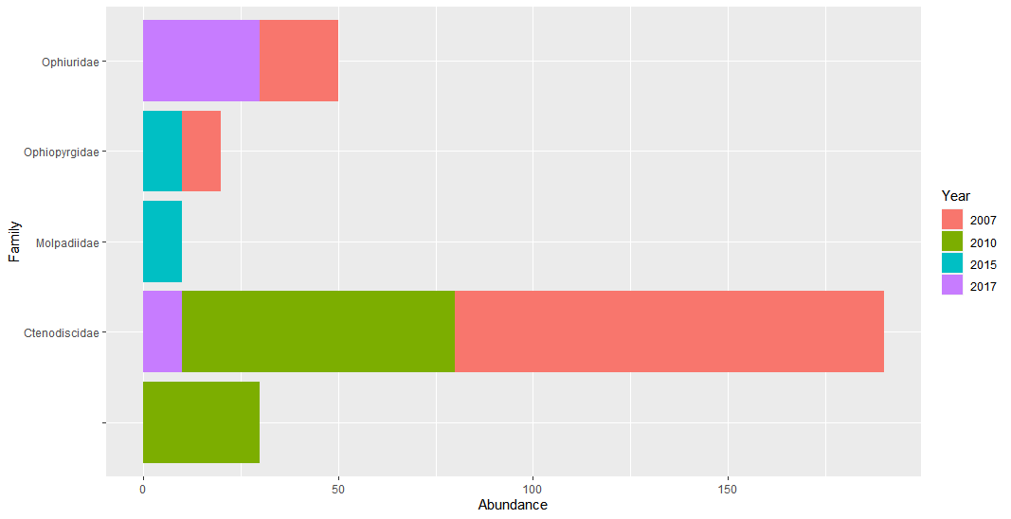
Echinoderma Families by Year
Ophiuroidea indet.
(Ind. /m²)

Slide 6
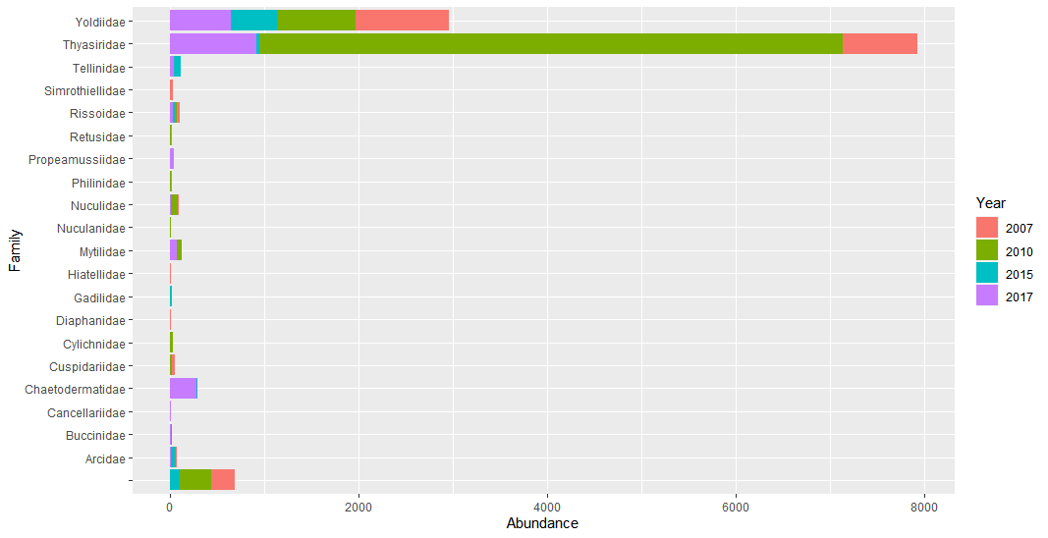
Mollusca Families by Year
Indet. others
(Ind. /m²)

Slide 7
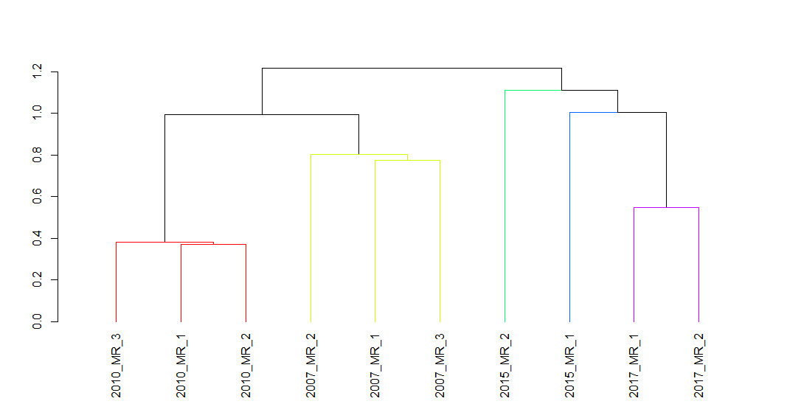
Cluster analysis with abundances hellinger transformed
Simprof test:
Method.cluster=«average»
Method.distance=«euclidean»
Alpha=0.05
Num.expected=1000
Num.simulated=999

Slide 8
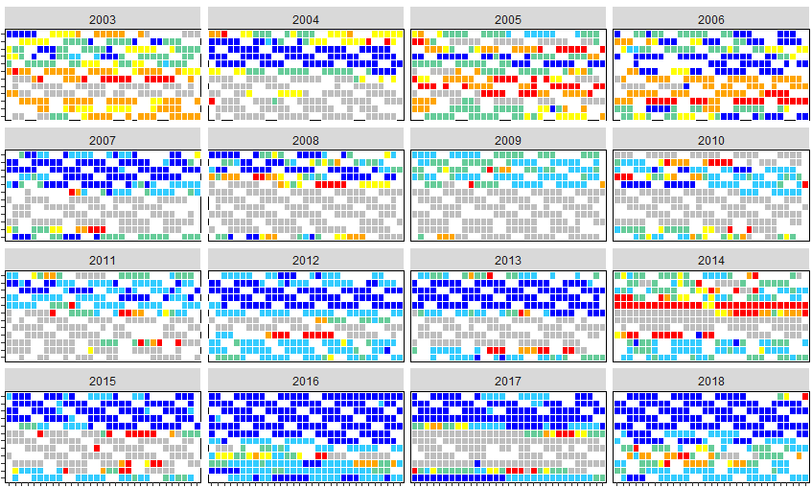
Daily sea ice type station MR from 2003 to 2018 calculated from ice charts from Norwegian Meteorological Institute
Station: MR
DEC
NOV
OCT
SEP
AUG
JUL
JUN
MAY
APR
MAR
FEB
JAN
Very Close Drift Ice
DEC
Close Drift Ice
NOV
OCT
SEP
Open Drift Ice
AUG
JUL
JUN
Very Open Drift Ice
MAY
APR
MAR
FEB
Open Water
JAN
MONTH
Ice Free
DEC
Fast Ice
NOV
OCT
SEP
Unkown/Unavailable
AUG
JUL
JUN
MAY
APR
MAR
FEB
JAN
DEC
NOV
OCT
SEP
AUG
JUL
JUN
MAY
APR
MAR
FEB
JAN
01
10
20
30
01
10
20
30
01
10
20
30
01
10
20
30
DAY

Slide 9
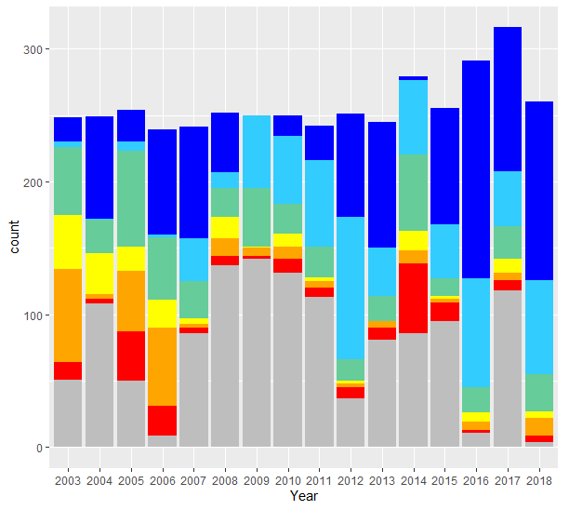
Very Close Drift Ice
Open Water
Close Drift Ice
Ice Free
Total sea ice type days per year at station MR
Open Drift Ice
Fast Ice
Station: MR
Very Open Drift Ice
Unkown/Unavailable
RIJPFJORD

Slide 10
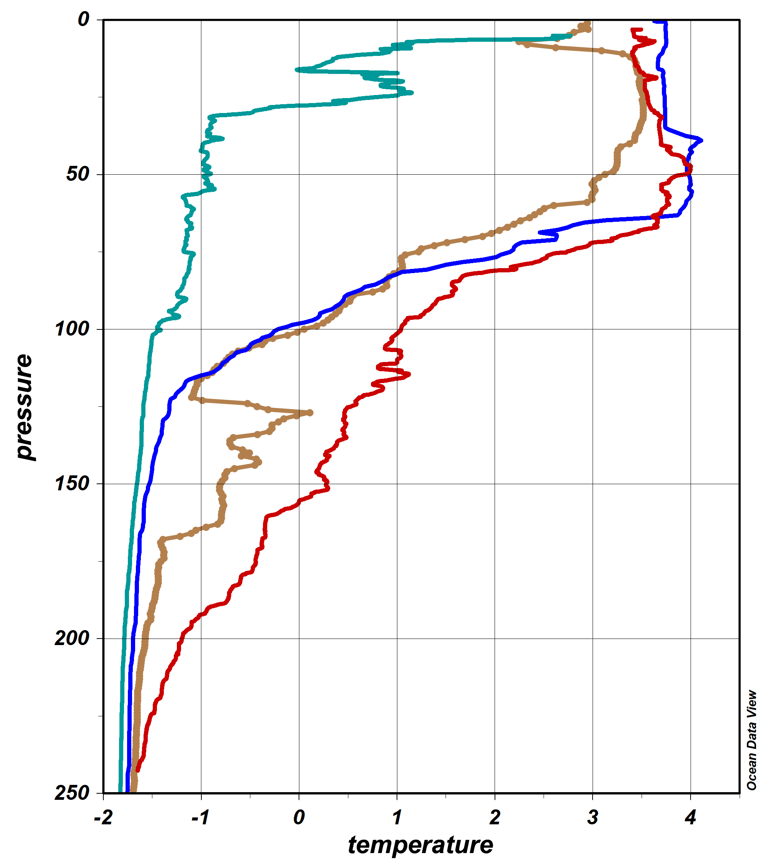
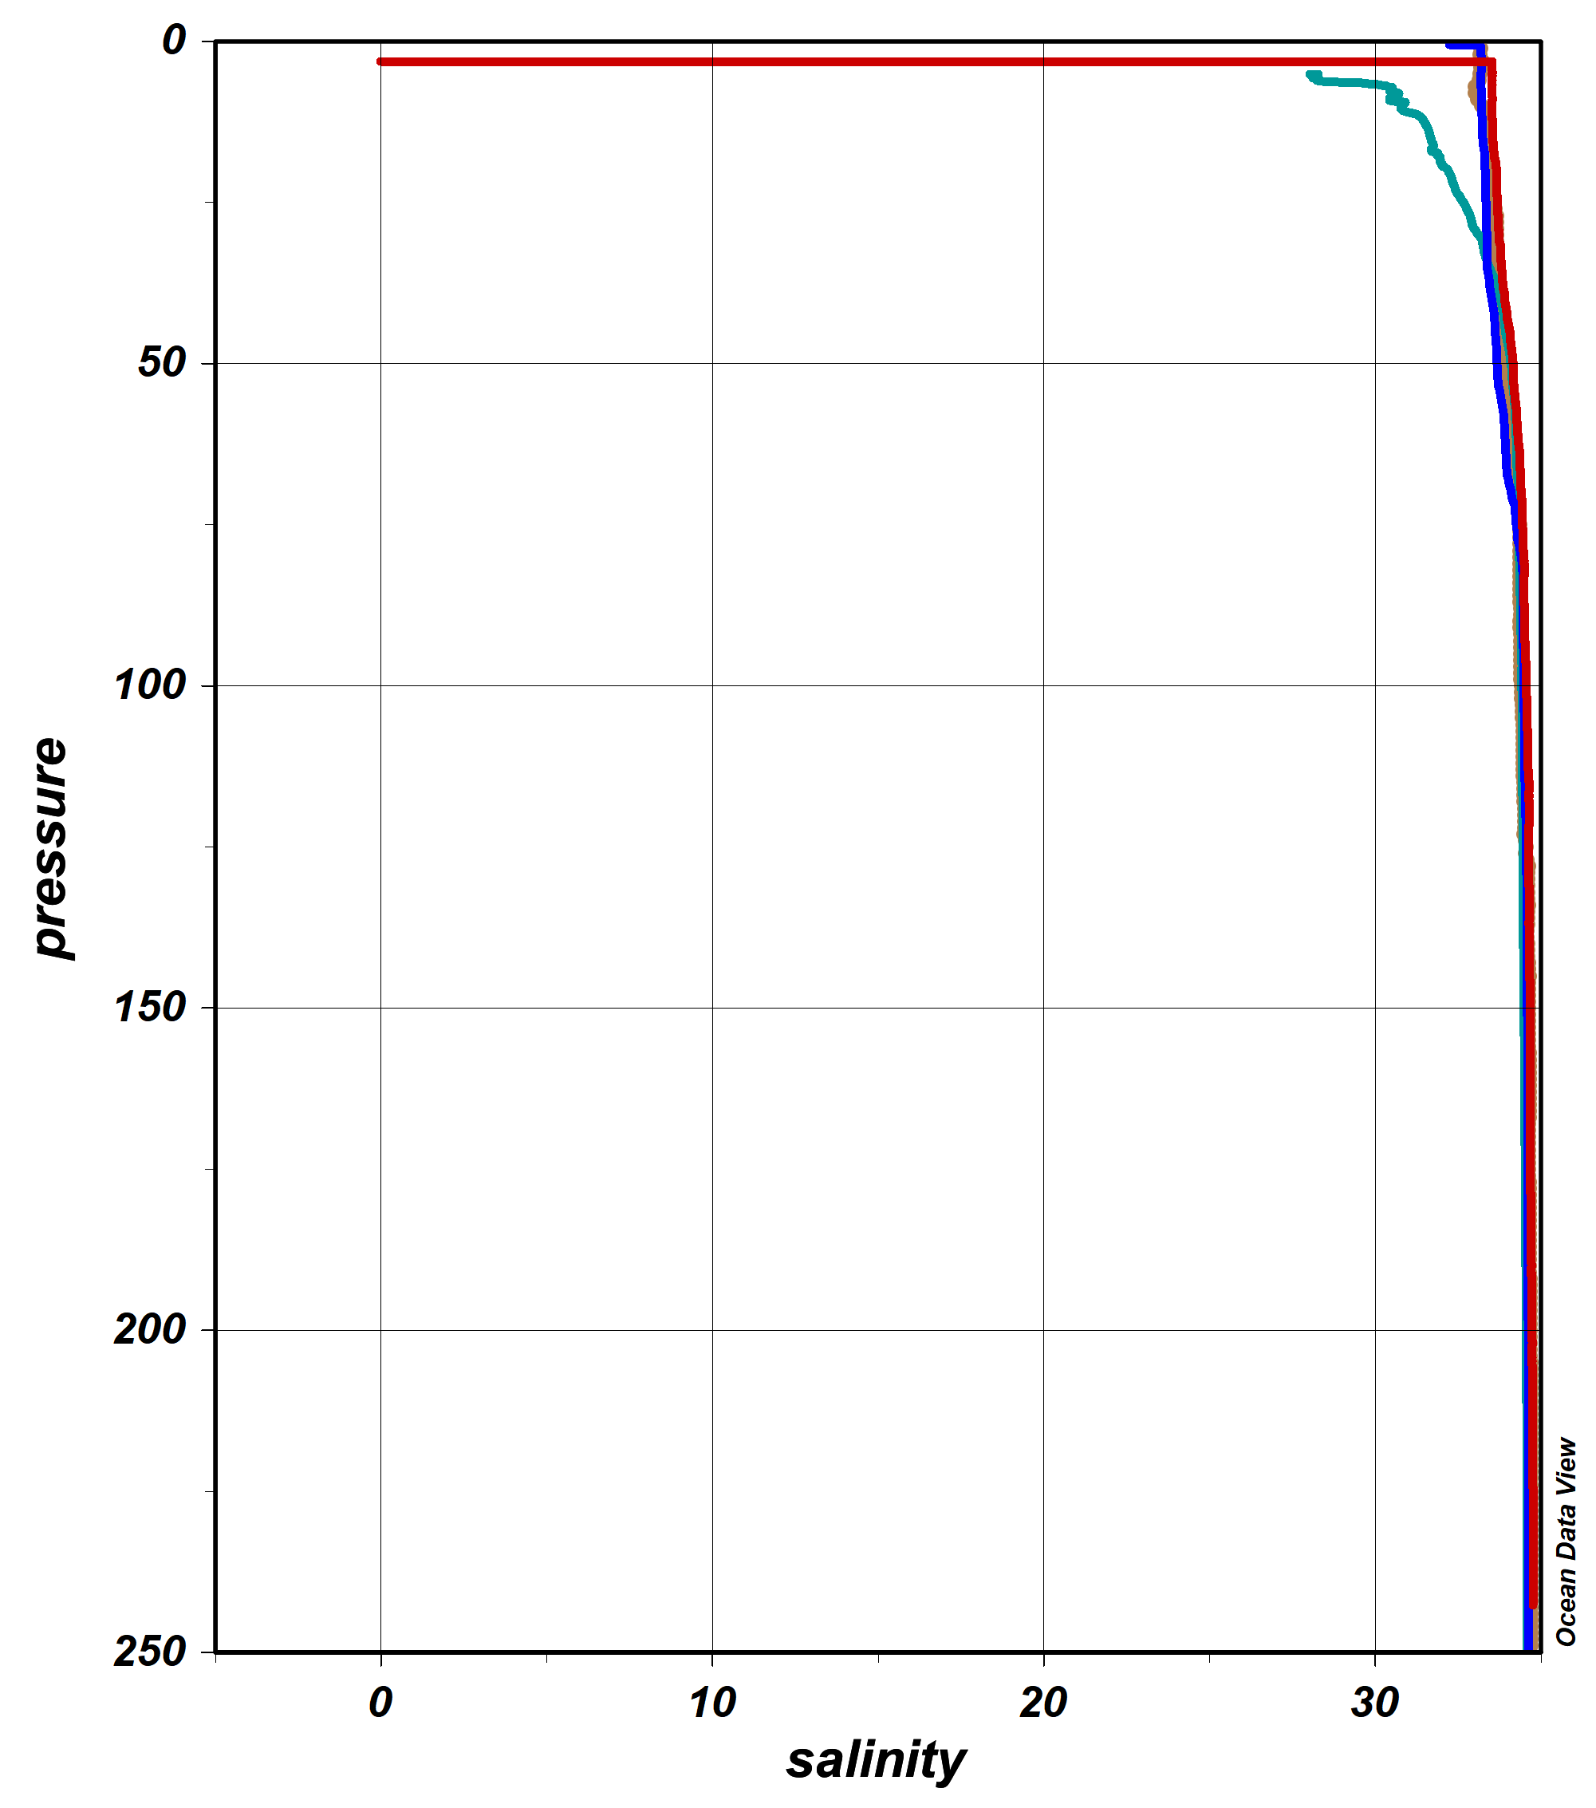
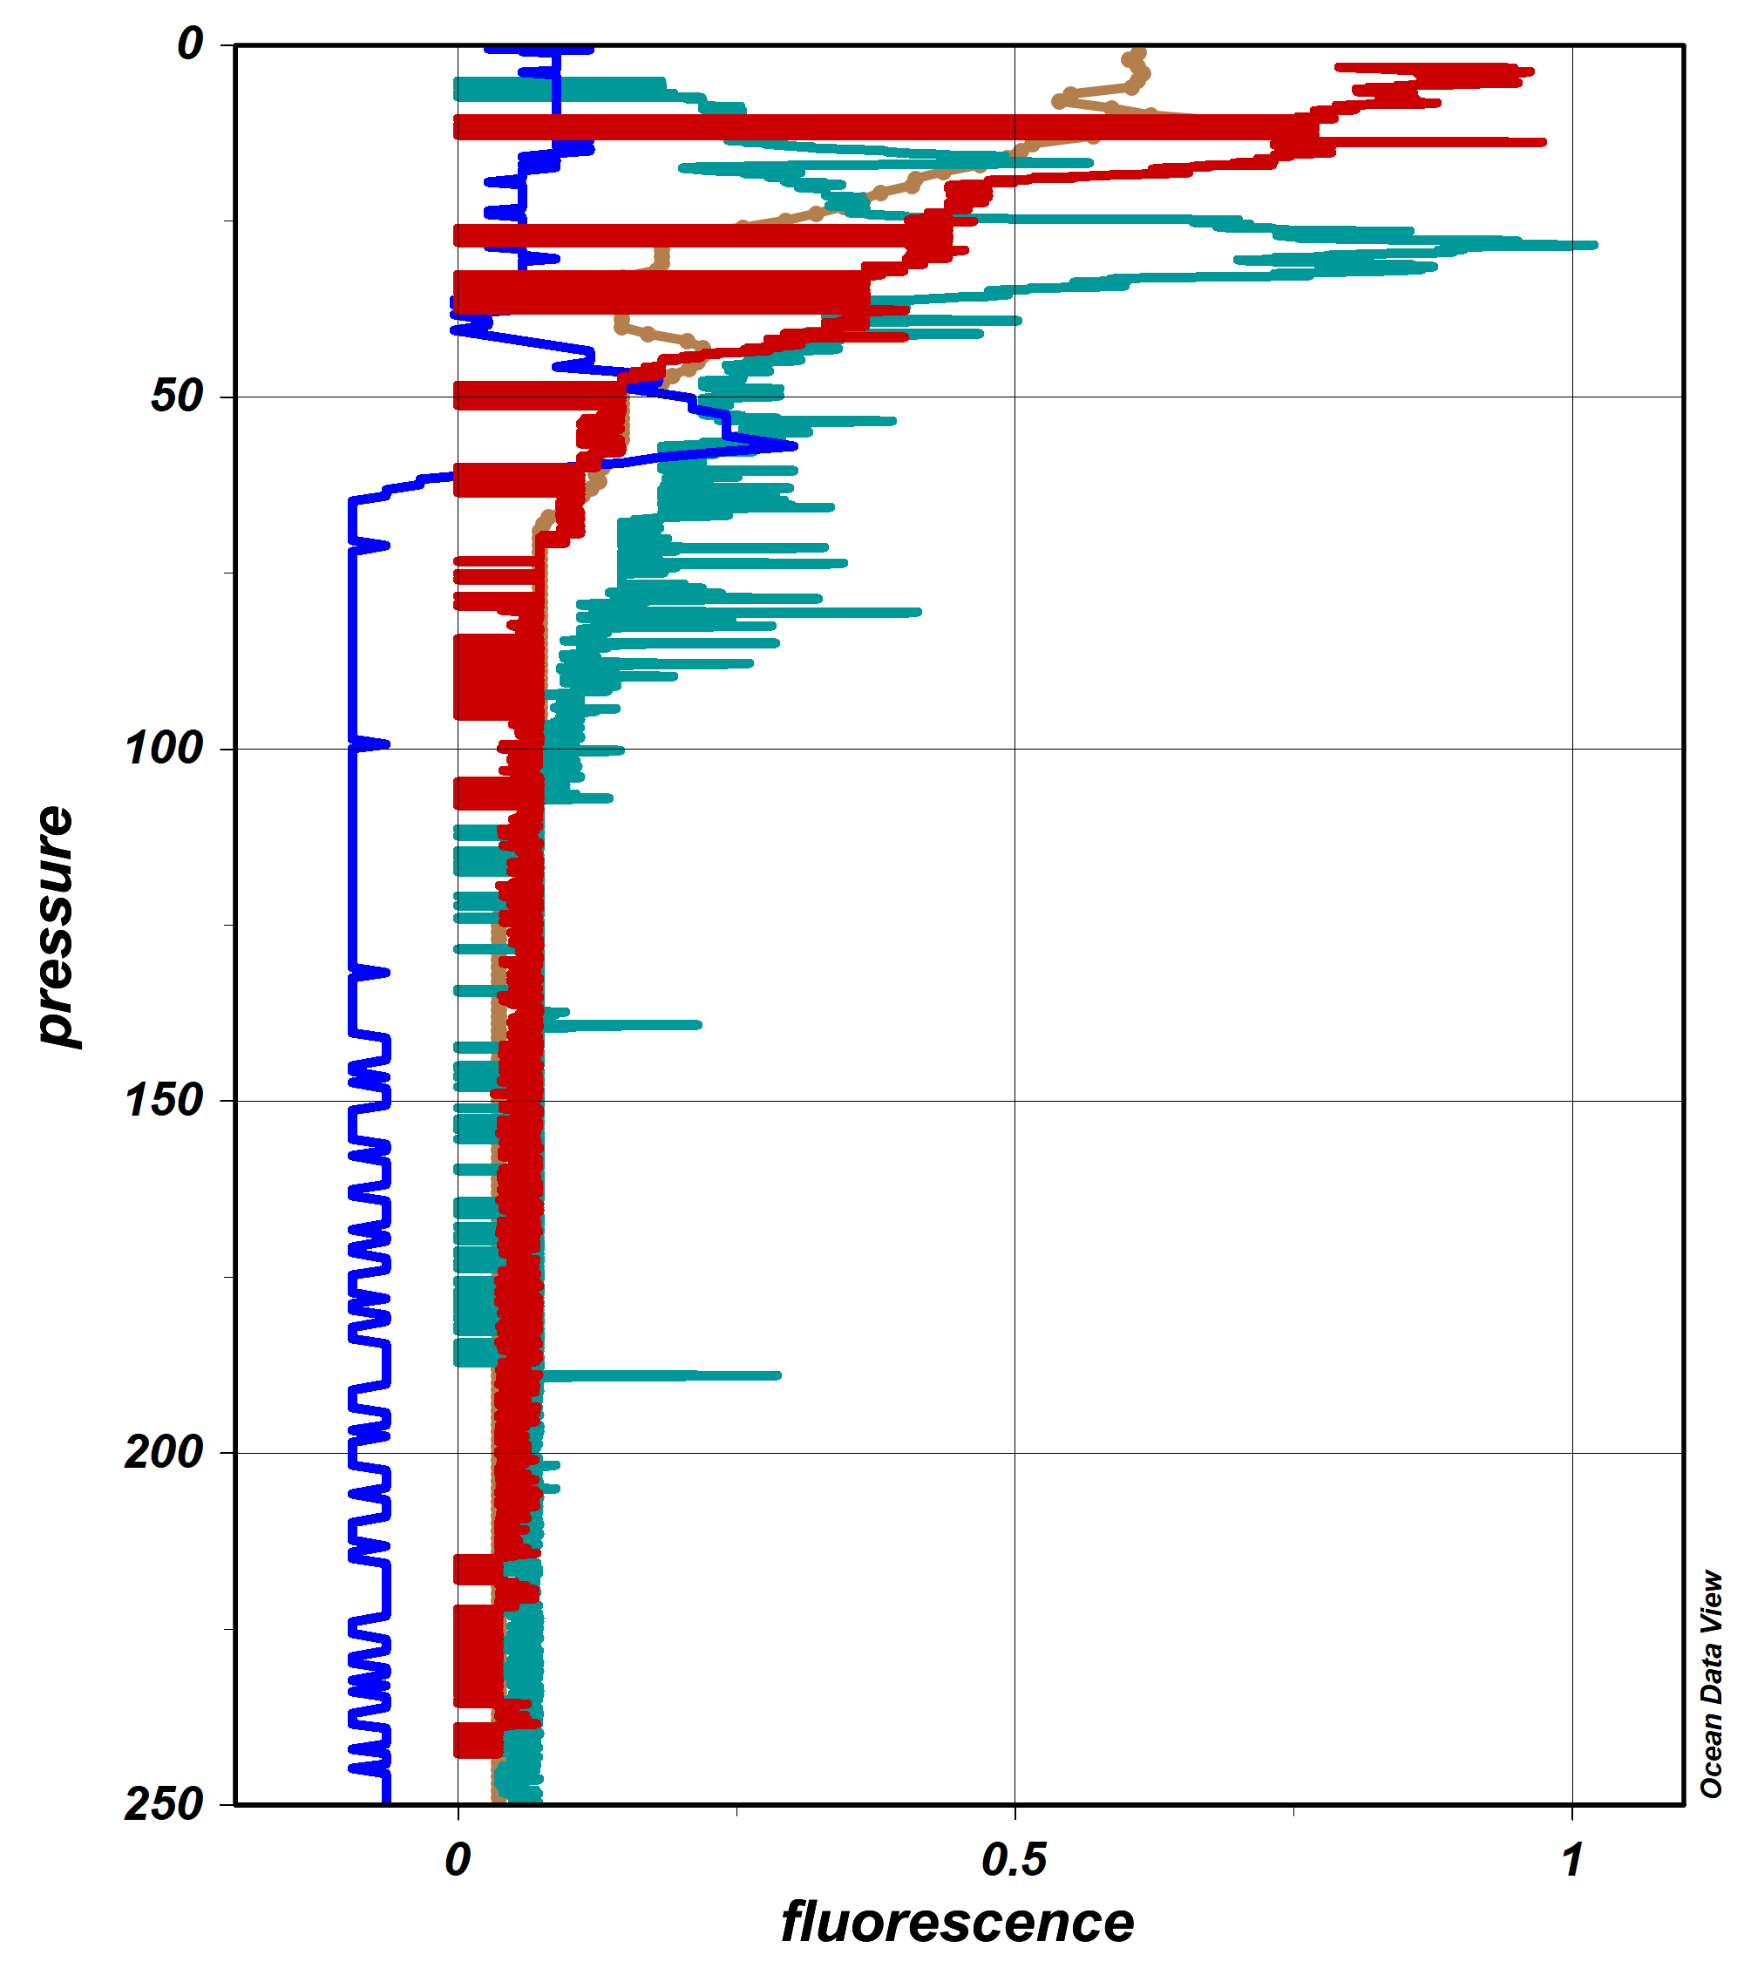
CTD preliminary results at MR station
2007
2010
2015
2017

